Slide 1
Seasonal Employment in Rural Areas
(SEiRA)
A Project on Transfer and Management of Rural Technology

Slide 2
Introduction
Today’s scenario suggest a high rate of unemployment in the rural areas especially for women which, thus, is a very crucial roadblock to their development. The central idea behind the project is to be able to generate seasonal employment to the rural household, especially women and thus, not only uplift their status but also benefit the rural community in general.
Notes:
Vikash

Slide 3
The plan is to constitute a group of rural women and provide them with the work of preparing food for which they will be paid accordingly. As they were previously unpaid for their skill, they would feel self-reliant and motivated.
This plan also aims at direct utilisation of the rural produce, e.g. rice, vegetables, fruits, etc., for this occupation of women without the involvement of middlemen and thus, benefit the farmers in terms of better returns.
Notes:
vikash

Slide 4
Motivation
Empowerment comes from Employment.
Women possess skill set which can be developed and utilised.
Rural producers deserve better returns for their produce.
There is a need of better storage facilities for rural produce to increase its shelf-life which would ensure increased returns for rural household.
Rural upliftment is necessary in order to progress towards a better India, since a major portion of India resides in the rural areas.
Notes:
Vikash

Slide 5
The Problem Statement
One of central problems in the rural areas is the extortionate unemployment rates, especially for women(24.26% of rural women in 2001 to 12.9% in 2011).
The farm produce, e.g. rice, vegetables, etc., in rural areas often fall prey to middlemen who charge the farmers highly for the same.
Due to shortage of demand for the produce in the rural areas, the farmers have to travel to distant markets, raising their expenditure.
Notes:
Prakhar

Slide 6
Objectives
Creating job opportunities for women in rural areas.
Eradicating role of middleman in rural areas.
Enhancing standard of living of rural community.
Providing quality food at relatively cheaper cost.
We propose to have a Vacation Mess System, wherein during the vacations, when the general mess closes down, the food would be cooked by the rural women in the local villages and be brought to the private mess for distribution, the mess being managed by the contractor.
Notes:
Prakhar

Slide 7
Methodology
Firstly, two surveys has to be conducted
For the rural areas to be able to estimate the capacities and interests of the rural people, both men and women for the program.
For the students to know if they would support the program.
Contractors would be contacted and convinced to procure food from the rural areas instead of their hired workers based on the following logic:
Regular employees tend to demand more than unemployed people as they would be happy for whatever they would get.
More number of rural workers would mean expansion of food production and hence better return in business.
Notes:
Sheet

Slide 8
Methodology(Cont’d)
A group of rural women would be constituted from those who are interested at first. They would work for the season and earn wages.
This would encourage more people to participate and hence increase the strength.
There would be an individual/group of rural people as suggested from among themselves or by the contractor, who would be in-charge of ensuring quality, hygiene and taste of the food. The member of this group would be continuously changing to ensure low biases.
The grains and other items for preparing the food would be procured directly from the local farmers, eliminating the role of middlemen and hence increasing the returns to the rural households.
Notes:
Sheet

Slide 9
Methodology(Cont’d)
The farm produce procured would be stored in the specialised silos which would be designed keeping in mind their cost and effectiveness.
The duty of transporting the cooked food would be of the contractor (he can also get it ensured by the local rural people). The transport facility would be cost-optimised and special arrangements would be made to protect the food from spoilage.
The transported food would be kept in the mess and distributed via buffet system, as happens currently.
In long term, the developed cooking skills of the rural women and the increased farm produce can be put to use for providing permanent self-sustaining employment to them, e.g. on the lines of AMUL, Lijjat Papad, etc.
Notes:
Sheet

Slide 10
Expected Outcomes
Rural women would be provided employment and hence would be empowered for self-reliance.
Rural farmers would be provided easily accessible markets for their produce and better returns by eliminating role of middlemen.
Farmers would be exposed to newer technologies of farming, storage and transportation due to a collaboration with students and also contractors who would do this in hopes of better returns and business expansion.
Notes:
Nischal

Slide 11
Expected Outcomes(Cont’d)
The consumers would get home grade food at cheaper (or same) rates, the quality of which would be ensured by:
First, the cooks, i.e. the rural women.
Second, the quality control group of the rural people.
Third, contractor through internal feedback (a reduction in number of customers would indicate falling quality)
Rural upliftment in terms of skill-set development and hence opening up long-term employment opportunities for the people.
Notes:
Nischal

Slide 12
Groundwork – Expectations from Survey
Before surveying the Village Balrampur, we wanted to find out the following:
Number of unemployed people in the Village.
Percentage of women out of the unemployed people.
The will of these women to work in groups.
The will to work if they get paid for it.
If their families are supportive of them to work.
The image they perceive of themselves developing from the work
Notes:
Ankit

Slide 13
Groundwork – Village Survey
The Survey that was conducted in the Village comprised of interactive talk with the villagers and a set of general questions:
Name of the women
Number of family members and the percentage unemployed.
Employment state of women and their involvement in group service.
Will to work in groups in order to make food for the students.
Hurdles and suggestions regarding the same.
Notes:
Nischal

Slide 14
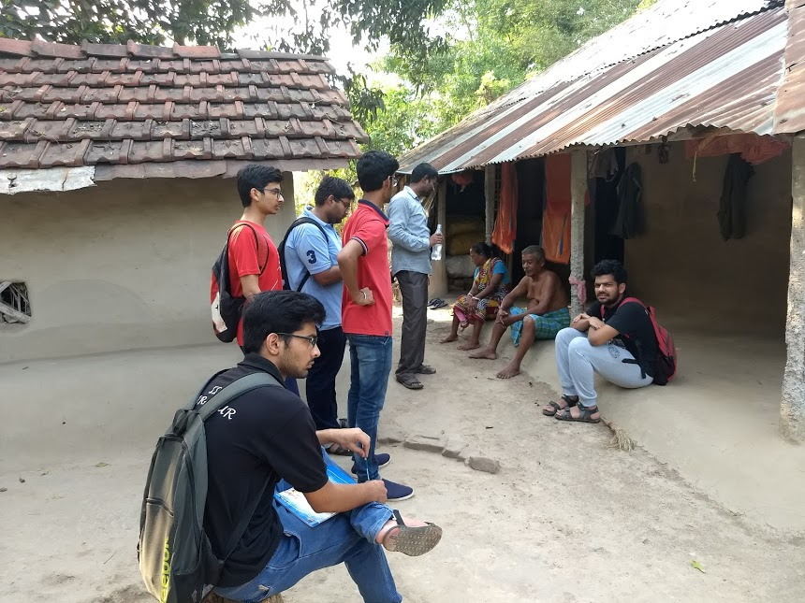

Slide 15
Groundwork – Village Survey Results
Name of person | No. of people in the family | No. of family members employed | Response towards the program
Sandhya Sen | 4 | 2 | Not interested
Rupali Sutradhar | 3 | 2 | Couldn’t decide
Chandra Sutradhar | 14 | 5 | Interested
Mousutra Das | 4 | 1 | Interested
Subhash Sen | 3 | 1 | Interested
Biswanath Das | 2 | 1 | Interested
Notes:
Prakhar

Slide 16
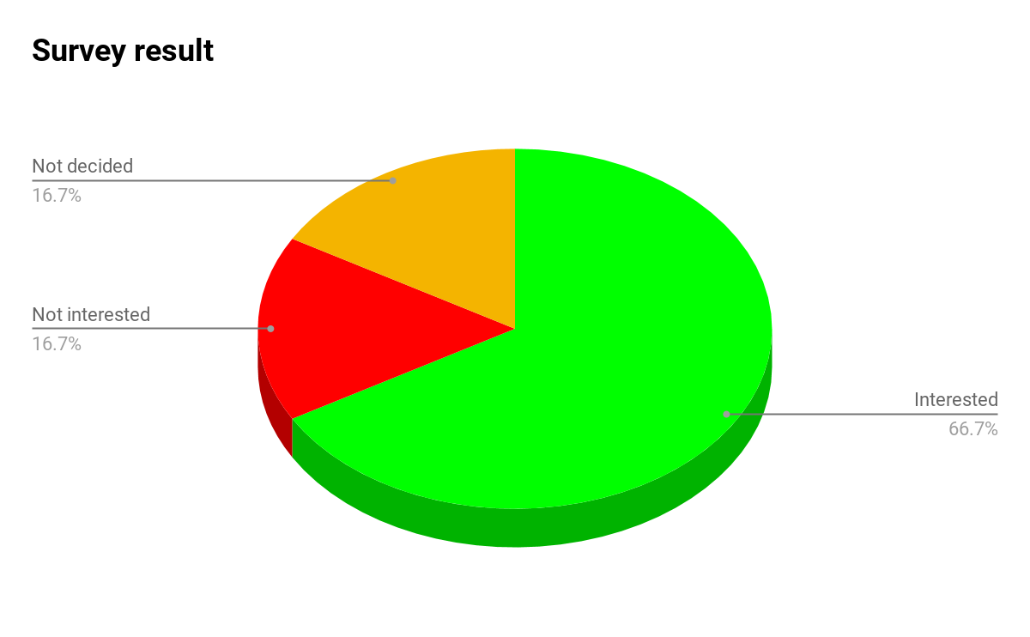
Groundwork – Village Survey Results
Notes:
Prakhar

Slide 17
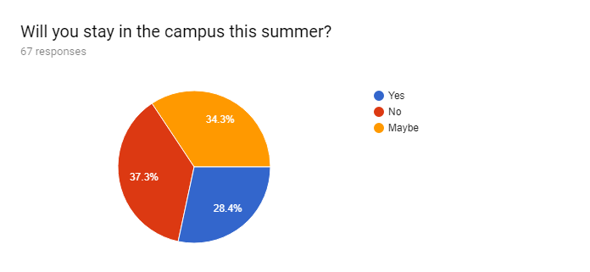
Groundwork – Student Survey Results
Result 1:
Notes:
Prakhar

Slide 18
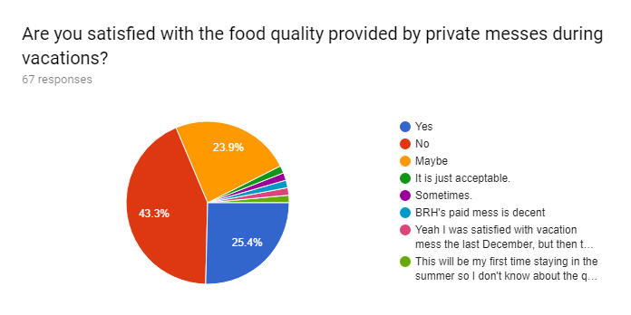
Groundwork - Student Survey Results
Result 2:

Slide 19
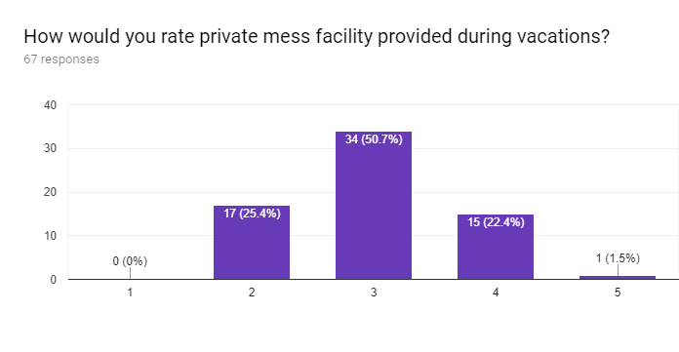
Groundwork - Student Survey Result
Result 3:
Notes:
Prakhar

Slide 20
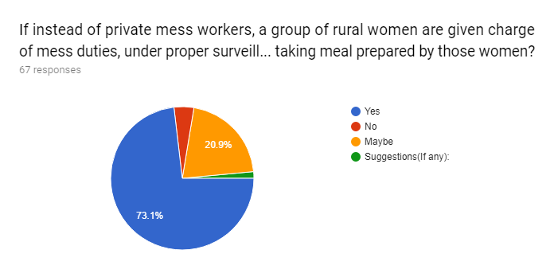
Groundwork - Student Survey Result
Result 4:
Notes:
Prakhar

Slide 21
Working Model
Based on the methodology and the survey results that we received, we devised the following:
Contractors would hire workers from among the rural women who are willing for community service from their homes, instead of the professional workers.
The tangible capital, including the utensils and other logistics and transportation, would be provided by the contractor as before.
Transportation would be facilitated through the specialised vehicles designed to safeguard perishable food.
Utensils and logistics would be provided by the contractor as before.
The experienced women of the community of women would direct and supervise the work of the community.
The male unemployed members of the family or the village would ensure the transport and other logistic management
Notes:
Sheet

Slide 22
Working Model(cont’d)
The quality and quantity would be ensured based on a 3-tier system:
A student who would be staying back would be responsible to ensure the quality of food. (He is not needed to visit the village everyday)
The contractor would be responsible to ensure visit to the village regularly while transportation of food and thus ensure quality & quantity.
The rural women in association with the panchayat would nominate a women representative for every session so as to keep an internal check on the quality of food.
A dwindling number and increasing complaints of the customers for the mess would also indicate falling quality resulting in falling profit for the contractor and hence would ensure the proper working of the mess.(Internal feedback)
The ration of raw materials for the food would be stored in special silos in the village as maintained and managed by the 3-tier committee.
Notes:
Sheet

Slide 23
Revenue Model
The following would be the revenue, expenditure and income for the system:
Initial capital would be arranged by the contractor as he does now.
According to the talk with Mr. Ashim Das, a Vacation Mess contractor, the following is the expenditure expected:
Worker:
Existing worker: INR 309 per head per day.
Rural women(Estimated): INR 150 per head per day.
Transport: INR 3 per kilogram per day(Considering 50 kg food transport worth INR 150 per day).
Storage: Initial capital required.
Raw Material: As existing earlier based on market price(seasonal).
This data has been compiled using the analysis of worst case.
Notes:
Sheet

Slide 24
Revenue Model(cont’d)
The cost incurred by the contractor would be, at maximum, the cost he was paying earlier, along with the development of the society due to employment generation for the rural people.
Rural women would be earning for the work they were previously doing for free.
The incentive of pay would ensure greater participation and hence increased variety and specialisation on the food items.
This would increase the chances of development of a community cooperative group of villagers that would be setting up their own industry(In the lines of AMUL, Lijjat Papad, etc.)
The confidence of the rural in themselves would gradually increase and this would lead to their development.
Notes:
Sheet

Slide 25
Use of Technology
The model has two basic technological requirements for the facilitation of quality food to reach the customers:
Transportation: The prepared food would have to be transported from the village to the mess. The village is expected to be at a radius of 6 km from the mess and hence would take approx. 10 minutes to reach the mess at 35 kmph as is feasible considering rural roads. Specialised trucks/vans having insulation of insulations of jute(locally abundant) and thermocol would be designed and the technology for their design would be transferred to the rural village and hence would add to the skill of the people in making such containers.
Notes:
Ankit

Slide 26
Use of Technology
Storage: The ration for the preparation of food would be centrally allocated to the community and stored in special earthen silos constructed with layerings of jute(to regulate temperature of the silo) as was being done in the rural areas of the early 1900s. This safety of the raw materials procured in the silos would be ensured by the insulated water-proofing provided to the silos.
Moreover, regarding the quality of prepared food and the feedback of customers so as to regulate the functioning of the mess is very important too and would be ensured via a Mobile Application wherein the user can rate the food and give feedbacks about it, order as to what their preferences are based on which the menu would be prepared in later stages of the model being implemented.
Notes:
Ankit

Slide 27
Conclusion
As our project aims to infuse working spirit among rural women and also a notion of cooking skills as an asset rather than their liability, to make them self-dependent. We got our first boost about realizing this project after conducting the survey in the village, where surprisingly we found the majority of women welcoming our initiative and agreeing to cooperate.
But we had to estimate the consumer's(which in this case is the student community on campus) interest to proceed further. Here again, as the survey showed earlier explains, we were supported by the majority as they seemed like fed up with the services of private messes. We have also received some very encouraging suggestions which we have discussed upon.
Notes:
Ankit

Slide 28
Conclusion(cont’d)
Now as we are getting both demand and supply for our project with such a great support from both side, all we need is a little cooperation from the administration, to successfully implement this as the perfect win-win situation.
We have also envisioned to expand the program in future to get the supply for all types of food products (e.g. papad, pickle, etc.) if we are successful in the initial phase of the implementation. Also, we have planned to provide avenues for the rural women having a particular skill and conduct vocational training for the interested women, in later future.
Notes:
Ankit

Slide 29
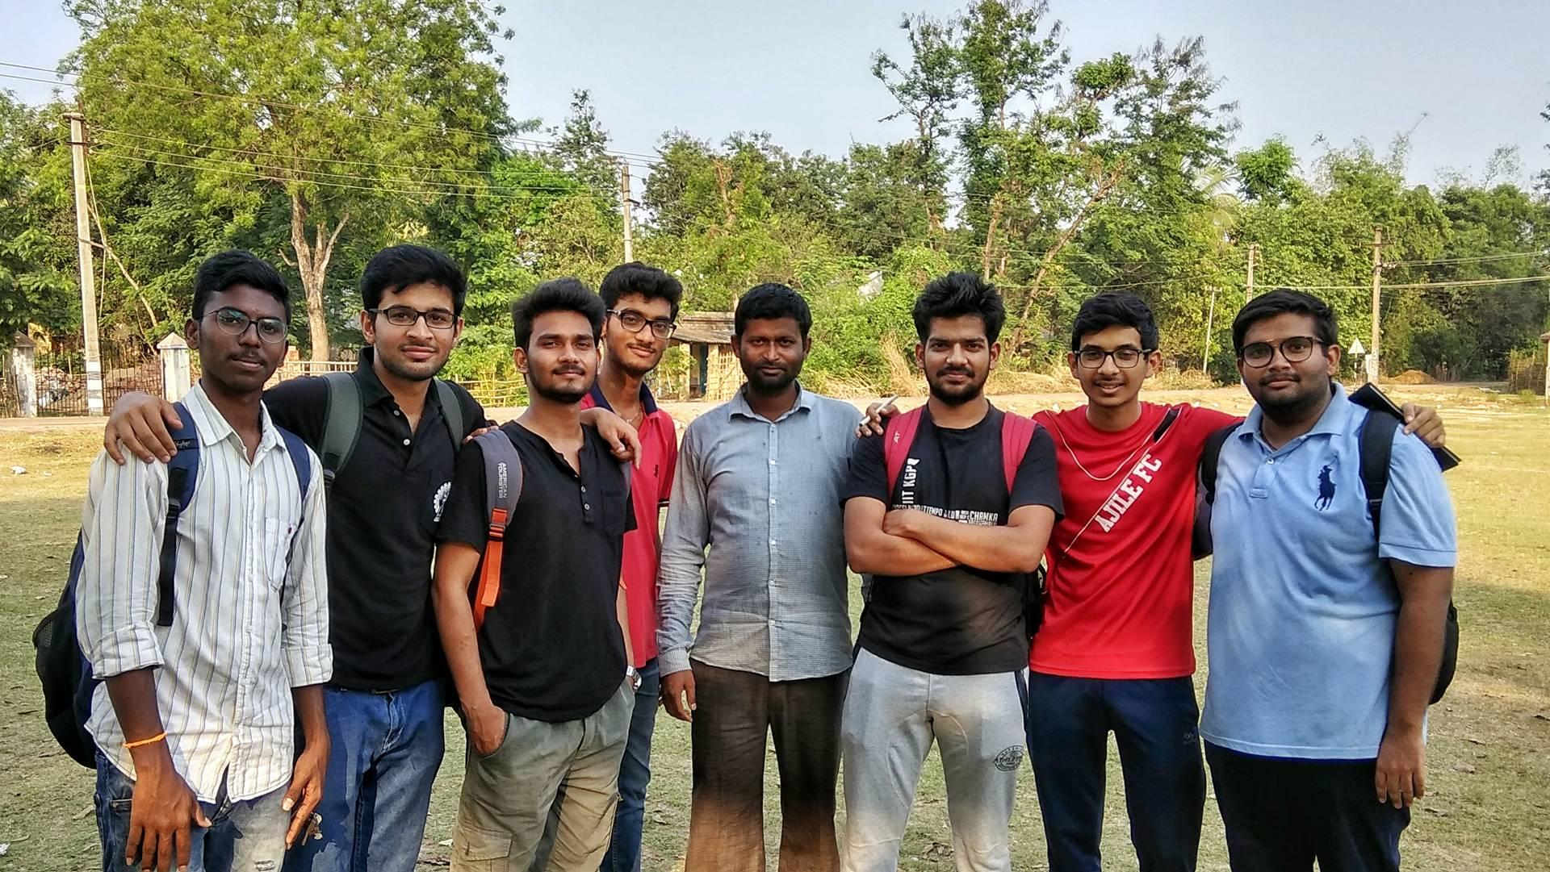
Field Visit to Balrampur Village

Slide 30
A Proposal by Group 8
Ankit Gupta(16MI33004)
Netrambaka Akhil(16MI10018)
Prakhar Tripathi(16MI33011)
Raj Kumar Singh(16MI33012)
Udit Agarwal(16MI31015)
Nishchal Bagele(16MI10020)
Sheet Kushal(16MI10031)
Vishal Chaudhary(16MI31018)
Deepanshu Sinha(16MI3PE02)
Vikash Mishra(16MI3PE03)
Arava Arun Kumar(16MI31002)
Priyanshu Ghosh(16MI10022)
Raushan(16MI10024)
Sai Kishore Reddy(16MI33010)

Slide 31
THANK YOU

